Slide 1

Back-End Project
Team Details:
Group No. 20
Atharav,2310990053
Irfan sood,2310990693
Supervised by: Mr.Vikas Patel
Chitkara University Institute of Engineering and Technology, Chitkara University, Punjab

Slide 2
Table of Contents
Introduction
Frontend
Backend
Code Highlights
Output
Integration & Workflow
Challenges & Solutions
Future Enhancements
Conclusion

Slide 3
Introduction
Objective: Demonstrating a form to collect user data and a backend API for saving and retrieving the data.
Tools Used:
HTML, CSS, JavaScript (Frontend)
Node.js, Express.js, and File System (Backend)

Slide 4
Frontend - User Data Form
Features:
Collects user details: Name, Email, Age, Phone No, Address
User-friendly design with subtle styling
Validations for inputs
Code Example:
Highlights from the HTML form structure.
Show styled elements with CSS (e.g., buttons, input fields).

Slide 5
Backend - API Overview
Technologies Used:
Node.js
Express.js
File System (for storing user data locally)
Endpoints:
POST /users: Saves user data to a JSON file
GET /users: Retrieves all saved user data

Slide 6
Backend-Code Highlights
File Handling:
Check and create the users.json file if not present.
POST Endpoint:
Parses and saves incoming user data.
GET Endpoint:
Reads and sends the stored user data.
Error Handling:
Catches and logs errors for both endpoints.

Slide 7
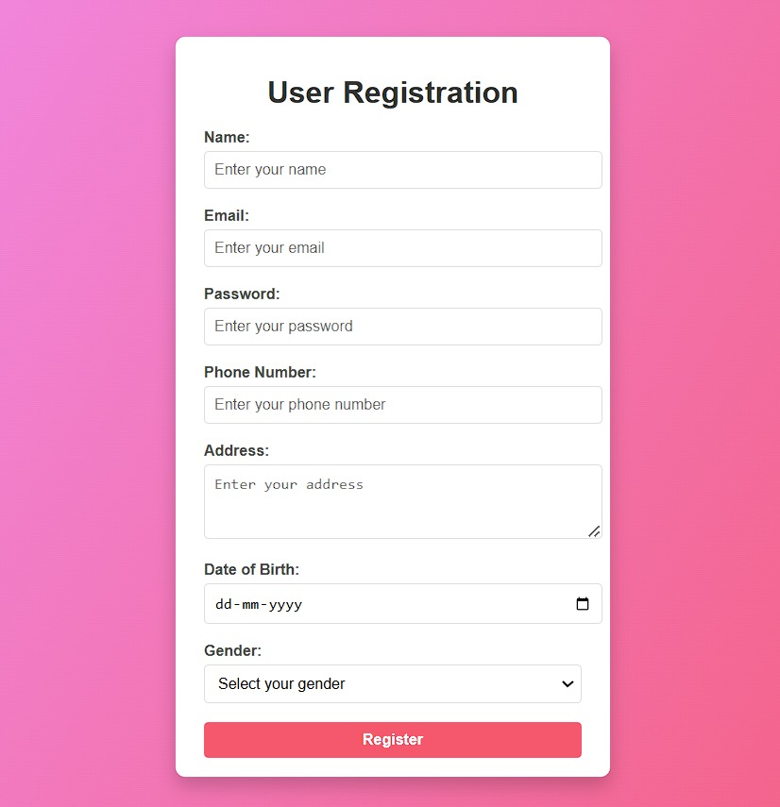

Slide 8
Integration and Workflow
Step 1: User submits the form on the frontend.
Step 2: Data sent via POST request to /users endpoint.
Step 3: Backend stores the data in users.json.
Step 4: Use GET request to retrieve and display saved user data.

Slide 9
Challenges and Solutions
Challenge: Handling file operations efficiently.
Solution: Ensure proper error handling and file checks.
Challenge: Managing seamless communication between frontend and backend.
Solution: Use clear API contracts and consistent JSON formatting.

Slide 10
Future Enhancements
Validation Improvements: Client-side and server-side validations.
Database Integration: Use MongoDB or MySQL instead of JSON file.
Frontend Enhancements: Add dynamic feedback for submissions.
Authentication: Secure user data with token-based authentication.

Slide 11
Conclusion
Summary:
Implemented a simple yet functional user data collection system.
Highlighted the seamless interaction between frontend and backend.
Next Steps: Explore database integration and enhanced features.

Slide 12


